Slide 1
Commenting in a model
For workshop participants

Slide 2
Common Model
Common model represents information requirements
Uses FHIR datatypes and Terminology interaction
Comments can be made against any element
Or the model as a whole
Can make notes against the comments
Comments represented as Tasks for formal disposition
Link to model
http://clinfhir.com/logicalModeller.html#8c28w

Slide 3
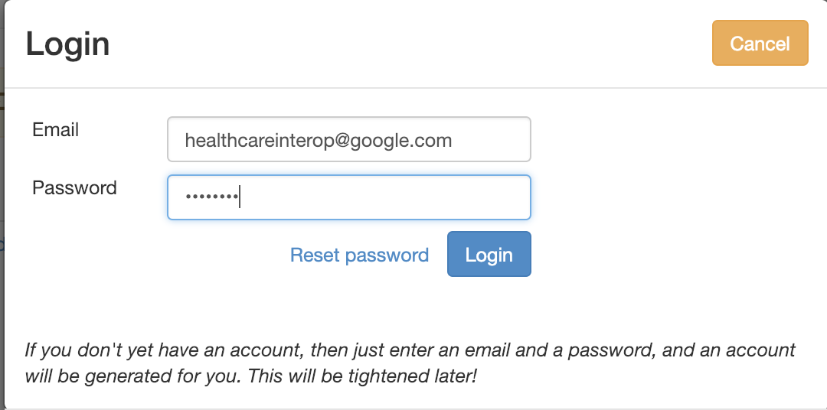
Login
Just email and password
Allows Comments and Notes to be added
Anyone can view
Can’t edit model

Slide 4
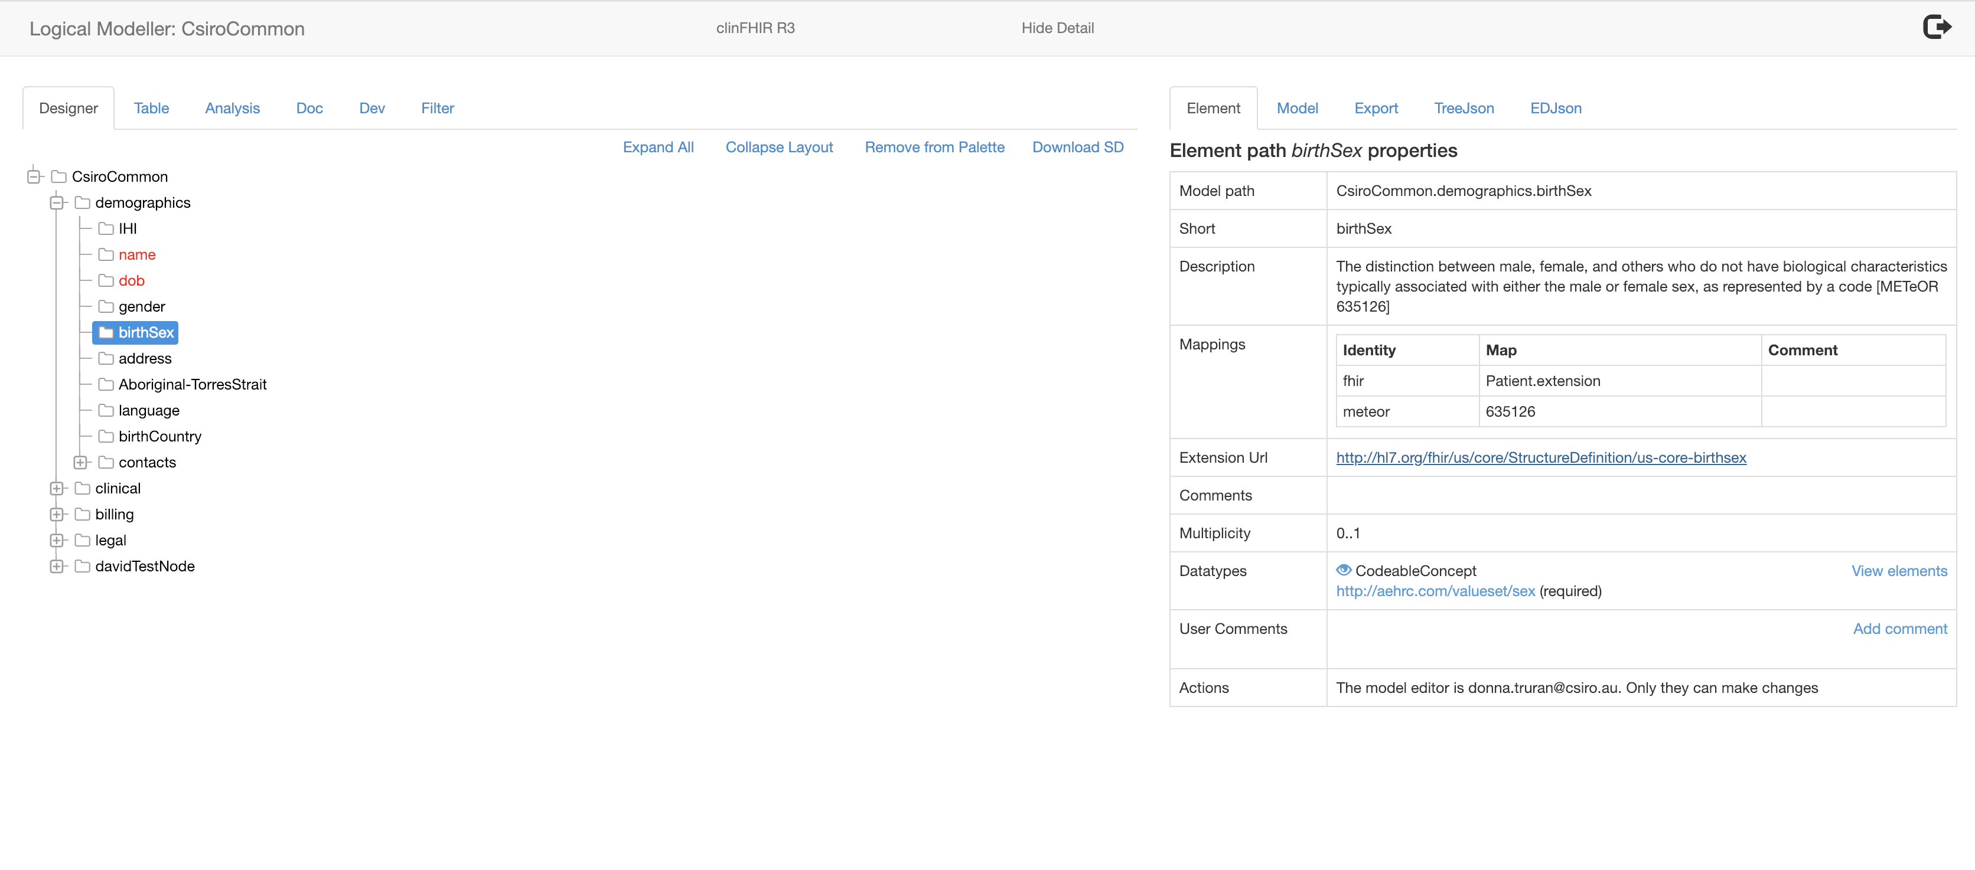
Model: Designer view
Details
Select Element

Slide 5
View Details of a ValueSet
Click link to view

Slide 6
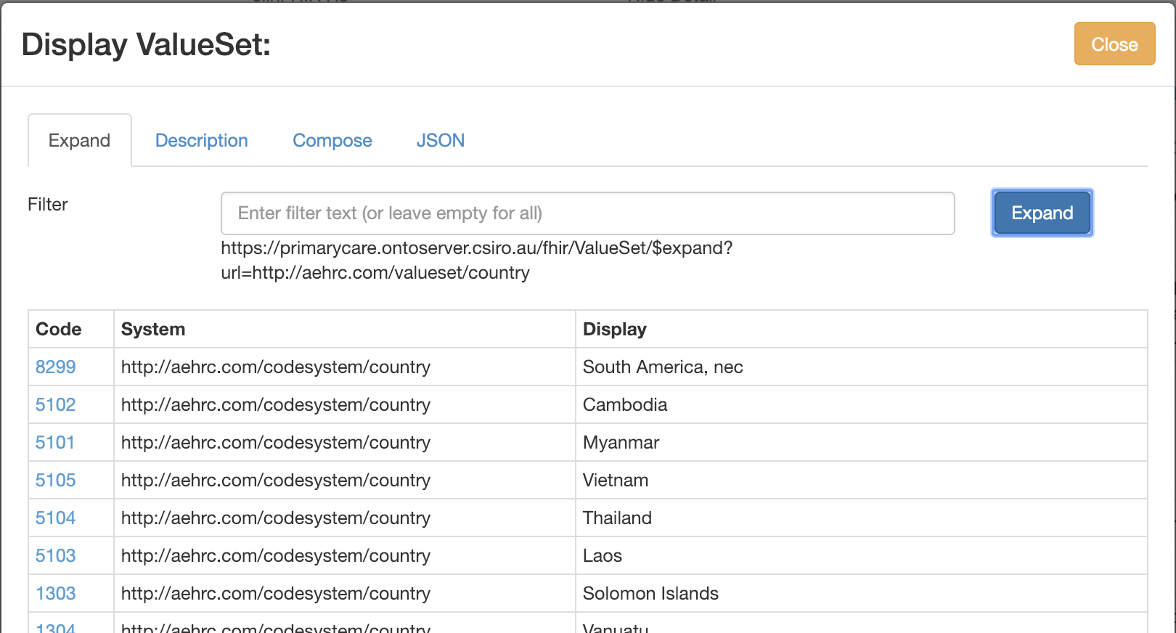
ValueSet browser
Click to view matching concepts
Filter by concept name

Slide 7
Making comments
Anyone can make a comment
Should be logged in (optional)
Can be for the whole model or an element
Can make notes about someone else's comment
Possibilities
Suggest new name
Update to element description or cardinality
Comment on ValueSet

Slide 8
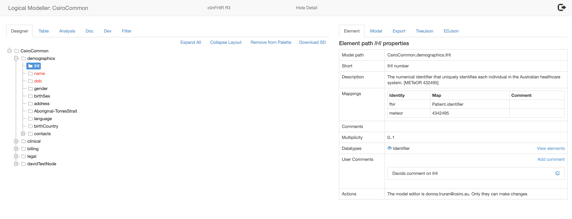
Comments
Add a new comment
(Logged in user only)
Edit comment
(Anyone can view)
Add a note – logged in user

Slide 9
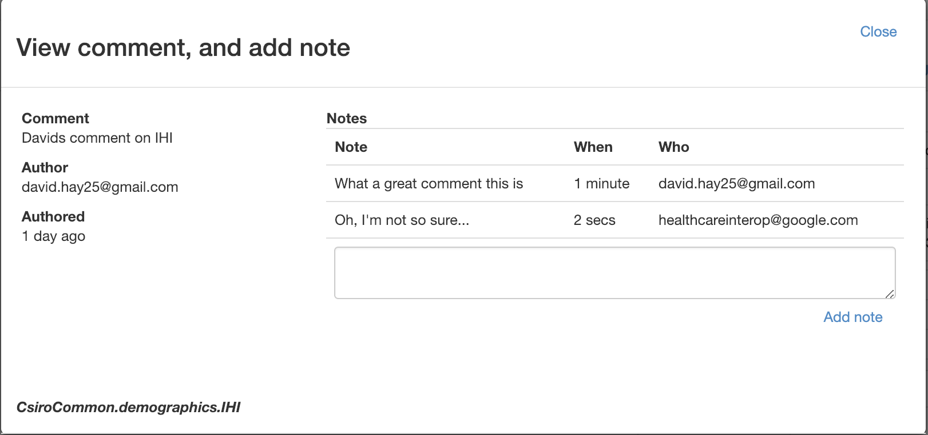
Comment details and notes
Notes that have been added
Details of comment
Add a new note
(Logged in user only)

Slide 10
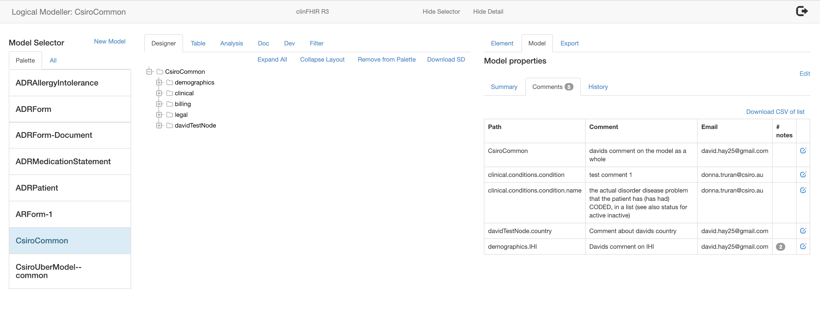
All comments for model
View / Add note

Slide 11
Task Manager

